Slide 1

Intelligent Battlefield
Surveillance System
Project Guide - Mrs.B.Siva Jyothi (Assistant Professor)
R.Sahithi A23126552235
B.Koushil A23126552198
K.Rohit A23126552210
Ch.Rohith A23126552202

Slide 2
Abstract
Current battlefield surveillance systems can detect targets, but they often rely on sensors and provide only basic object detection. They lack in distance estimation, real-time object tracking, automated mission summaries and intelligent decision-making. An AI-based battlefield intelligence system is needed to improve monitoring and support faster decision-making. The system provides useful information for military operations and supports faster decision-making.It helps reduce manual monitoring by providing real-time battlefield information to operators.

Slide 3
Problem Statement
Lack of an integrated battlefield surveillance system for object detection, distance estimation, movement tracking, and threat identification. This limits situational awareness and delays effective military decision-making.

Slide 4
Existing System
Present surveillance solutions use AI-based object detection and target geolocation through UAVs. However, these systems operate as separate modules and require significant human intervention for battlefield analysis. They lack integrated capabilities such as real-time multi-object tracking, explainable decision-making, and automated mission report generation. As a result, operators spend more time analyzing surveillance data, which can delay critical decisions during battlefield operations.

Slide 5
Proposed System
Our proposed system integrates AI-based object detection, distance estimation, and real-time object tracking to enhance battlefield surveillance. It provides threat assessment, explainable insights, and automated mission summaries, enabling faster and more informed decision-making without relying on sensors.

Slide 6
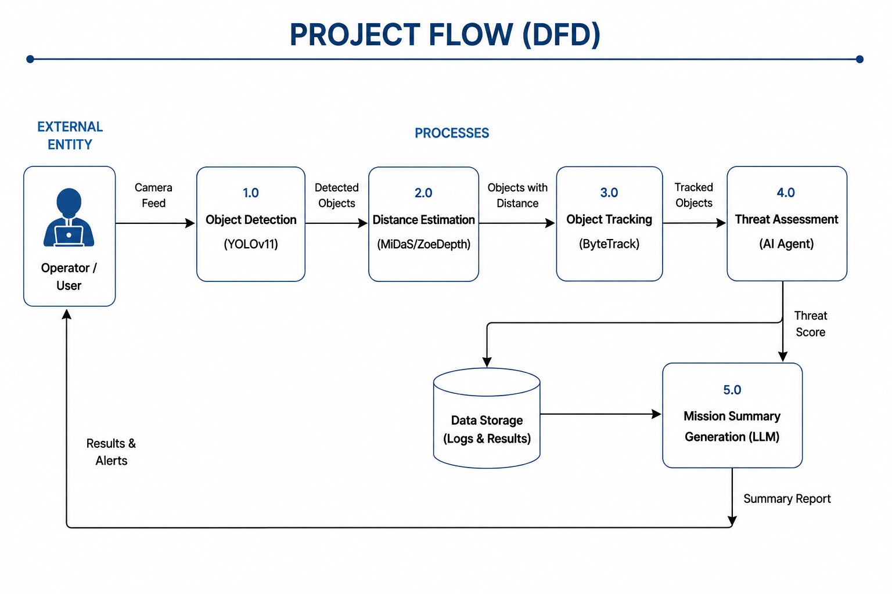
Architecture :

Slide 7
Tech Stack
Programming Language: Python
Computer Vision: OpenCV
Object Detection: YOLOv11
Distance Estimation: MiDaS / ZoeDepth
Object Tracking: ByteTrack / DeepSORT
Multi-Agent Framework: LangGraph
Large Language Model: Llama 3 / Mistral / Gemma (for intelligent analysis)

Slide 8
References
Automatic Detection of Civilian and Military Personnel in Reconnaissance Missions using a UAV (IEEE 2023)
IEEE: https://ieeexplore.ieee.org/document/10129575
Monocular-Vision-Based Moving Target Geolocation Using Unmanned Aerial Vehicle (Drones, 2023)
https://www.mdpi.com/2504-446X/7/2/87

